Slide 1
Innovation & Entrepreneurship for Engineers
Topic:
Team :
TA:
Instructor: Dr Shankar
IIT Madras , 15 Nov2026

Slide 2
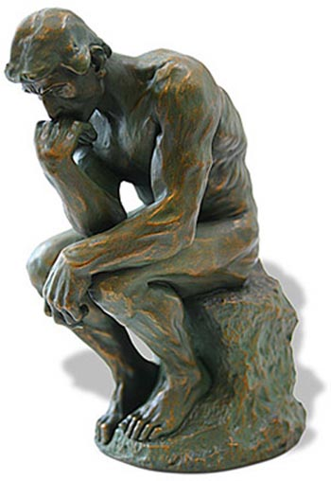
Innovation Demo Day
Problem Analysis
Who is
affected?
What is the
problem?
How is it
a problem?
When is
it a Problem?
Why is it
a problem?
Where is it
a Problem?
Fill in these 6 bubbles with information specific to your project
Notes:
2
Shankar, 27Aug'09
!nnovation flow at NCL

Slide 3
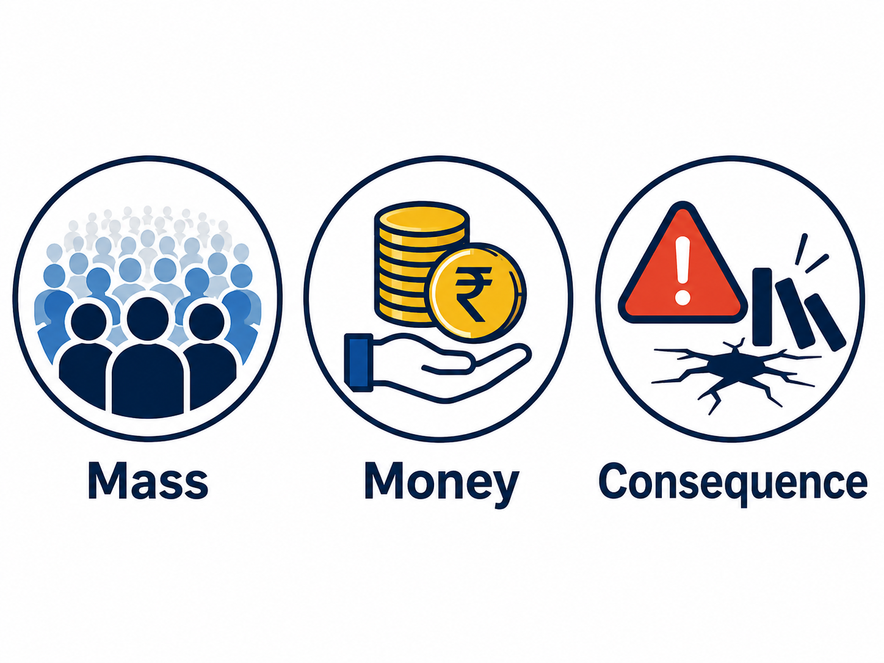
Innovation Demo Day
Worthy Problem
Low | Medium | High | Comments

Slide 4
Innovation Demo Day
Innovation
Innovation = Idea + New Value + Path to Market
Idea –
Customer –
New Value –
Path to Market –

Slide 5
Innovation Demo Day
Pasteur’s Quadrant
High
My Project
Fundamental
Understanding
Practical Application
Low
High
What is the Fundamental Understanding arising from your Project
What is the Practical Application of your Idea
Place your Project in the correct Quadrant
Low

Slide 6
Innovation Demo Day
TRL
Indicate the technology readiness level (TRL) of your Solution
Describe how you evolved your idea across various TRLs
TRL | Meaning
1 | Basic principles observed and reported
2 | Technology concept / application formulated
3 | Critical function / characteristic proof of concept
4 | Component / breadboard validated in laboratory
5 | Component / breadboard validated in relevant environment
6 | System / subsystem model or prototype demonstrated in relevant environment
7 | System prototype demonstrated in operational / space environment
8 | Actual system completed and qualified
9 | Actual system proven through successful mission / operational use

Slide 7
Innovation Demo Day
Idea Quality
Customer Desirability | Technical Feasibility | Economic Viability | Sustainability
Describe what makes your idea desirable, feasible, viable and sustainable
What aspects of your idea are patentable ?

Slide 8
Risks
Innovation Demo Day
Risks Mitigation
R1 • RESEARCH RISK
Will the science / technology work?
R2 • RESOURCE RISK
Can we obtain capital, talent, facilities, partners and time?
R3 • REGULATORY RISK
Can we legally certify and deploy it?
R4 • REPEATABILITY RISK
Can we manufacture / deploy reliably?
R5 • REVENUE RISK
Can the technology generate attractive economics?
Describe the various Risks and how you will mitigate them

Slide 9
Innovation Demo Day
Prototype
Demonstrate your Prototype of Proof of Concept (PoC)
Include Photo / Video / Working / User Feedback etc
Prototype / PoC

Slide 10
Innovation Demo Day
Evaluation
Criteria | Score (Low -1, Medium – 3, High – 5) | Comments
Problem Analysis
Problem Worthiness
Innovation
Pasteur’s Quadrant Analysis
Technology Readiness Level
Idea Quality
Risks Analysis
Prototype Quality
Presentation Quality
Handling of Q&A

